Slide 1
Foundational SAE -
Career Exploration
Be sure to follow the directions in the powerpoint and linked assignments
Submit on Schoology by the due date listed for each part.

Slide 2
Resource for all components of
Foundational SAE Career assignments
Click on SAE for All Learning Guide
Click on Start Course
Scroll down to find current assignment

Slide 3
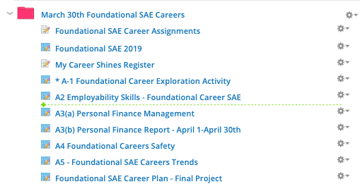
Assignments on Schoology
Presentation describing complete unit assignments.
Click on arrow to reveal all assignments in folder.

Slide 4
A1 - Due by Wed, April 1st at 11:59
Assignment will lock on 4/5
Part 1 is from the first nine weeks
If you received 100% you do not have to do anything else
If you did not submit or received less than 100% you need to complete and submit by 4/1/2020
Schoology Assignment

Slide 5
Part A2 - Due by Wed, April 1st at 11:59
Assignment will lock on 4/5
Employability and Career Readiness Skills
Schoology Assignment

Slide 6
Part A3a - Due by Friday, April 3 at 11:59
Assignment will lock on 4/8
Personal Financial MAnagement
Schoology Assignment

Slide 7
Part A3b - Due by Friday, May 1, 2020
Assignment will lock on 5/7
Financial Journal - April 1 - April 30th
You will use the financial journal feature in theaet.com to record your expenditures for the month. Instructions will be on schoology and here.
Schoology Assignment

Slide 8
Part A4 - Due by Friday, April 3, 2020
Assignment will lock on 4/8
Safety in career areas
Schoology Assignment

Slide 9
Part A5 - Due by Sunday, April 5th
Assignment will lock on 4/9
Trends in Career Areas
Schoology Assignment

Slide 10
Final Career Project - Summative
Assignment will lock on 4/17
Complete the Career Plan
Schoology Assignment

